Slide 1

Crowley isd graduation requirements for class of 2018 and beyond

Slide 2
What will we receive during course advisement?
Transcript of grades (if applicable)
Endorsement / PGP indication
Instructions on building a 4 year plan in Naviance
Link to the Course Description Guide
  Found on the Crowley ISD website you can also open the below link.
    http://www.crowleyisdtx.org/cms/lib5/TX01917780/Centricity/Domain/647/2015-2016%20HS%20Course%20Description%20Guide_Final.pdf

Slide 3
What is house bill 5 and the foundation graduation program?
Check out these videos developed by the University of Texas and the Texas Education Agency
  Parent Video
  Student Video

Slide 4
Foundation with Endorsement Requires 26 Credits:
Distinguished Level of Achievement:
4 English
4 Math
4 Science
3 Social Studies
1 Fine Art
1 PE
2 Foreign Language
6 electives (some with emphasis in a specific endorsement area)
Same credit counts as Foundation with Endorsement
Must take Algebra 2 as part of math requirements
Foundation only (Without endorsement) requires one less math, one less science, and only 4 electives for a total of 22 credits.

Slide 5
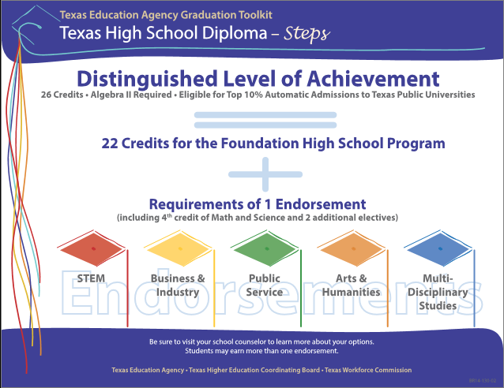

Slide 6

But, First… You’ve got to get your core classes!

Slide 7
English
English 1 (*)
English 2 (*)
English 3 (**) (D)
English 4 (**) (D) (other Language Arts courses can substitute for English 4 in most cases – Refer to the Course Description Guide for more options)
(*) Pre-AP option available
(**) Advanced Placement option available
(D) Dual Credit options available

Slide 8
Mathematics Options
Algebra 1 (*)
Geometry (*)
Math Models (MMA)
Algebra 2 (*)
Advanced Quantitative Reasoning (“AQR”)
Pre-AP PreCalculus
AP Statistics
Calculus
AP Calculus AB
AP Calculus BC
Underlined courses are required credits.
(*) Indicates Pre-AP is available for that course
Refer also to the Course Description Guide for more information about Mathematics course options

Slide 9
science
Biology (*)
Chemistry(*), Physics(**), or IPC
Two more Science credits. Options include:
Environmental Systems, Anatomy & Physiology,
AP Environmental Science, AP Biology,
AP Chemistry, AP Physics 1, 2, and C,
Microbiology/Pathophysiology, Aquatic Science,
Earth and Space Science, Forensic Science (CTE),
Advanced Animal Science (CTE),
Food Science (CTE)
(*) Pre-AP option available
(**) Advanced Placement option available

Slide 10
Social studies
World Geography (*) or World History (*)(**)
  (AP Human Geography may substitute)
US History (**) (D)
US Government (1/2 credit) (**) (D)
Economics (1/2 credit) (**) (D)
(*) Pre-AP option available
(**) Advanced Placement option available
(D) Dual Credit options available

Slide 11
Foreign Language
Students must complete two credits in the same language.
We offer:
  Spanish
  French
  German
  American Sign Language

Slide 12
Physical Education: 1 Credit
Can come from:
  Athletics
  PE
  JROTC
  Or the 1st semester of the first two years of Band, Color Guard, Cheer, or Drill Team

Slide 13

Fine arts
One full credit of Fine Art
  Art
  Choir
  Band
  Theatre
  Drill Team
  Dance
  Principals of Floral Design (CTE)
  Music Theory

Slide 14
Other means of credit
Credit by Exam – Offered for both advancement and recovery. See your counselor for details.
Dual Credit – Can be done through the school in English and Social Studies starting Junior year, or can be done over the summer.

Slide 15
Performance Acknowledgements
For outstanding performance:
  in a dual credit course
  in bilingualism and biliteracy
  on an AP test or IB exam
  on the PSAT, the ACT-Plan, the SAT, or the ACT
For earning a nationally or internationally recognized business or industry certification or license

Slide 16
Endorsements: Your future is your choice

Slide 17
Crowley ISD Pathway Offerings
Arts & Humanities | Business & Industry | Business & Industry (Continued) | Public Services
□Fine Arts □Social Studies □Languages Other Than English | □Ag Power Systems □Ag Natural Resources □Ag Plant Systems □Ag Animal Systems □Ag Environmental Systems □Interior Design □Architecture Design □Construction Technology □Graphic Design □Audio and Video Technology □Commercial Photography | □Fashion Design □Business Information Management □Marketing □Finance □Journalism □Debate & Public Speaking □Computer Software Design & Programming □Web and Digital Communication □Culinary Arts □Computer Technician & Network Administrator | □Education & Training □Health Science □Health Science – Pharmacy Tech □Biomedical Science □Cosmetology □Government & Public Administration □Law Enforcement □Firefighter □JROTC □Child Development
S.T.E.M.
□Mathematics □Science □Computer Science □Pre-Engineering (Project Lead the Way)
Multidisciplinary
□4x4 Grad Plan □Earning 4 advanced (AP or DC) courses □ 4 electives that center around becoming a college ready student

Slide 18
Which coherent sequence does this futures class lead to?
Futures in Arts, AV and Communication
  Graphic Design
  Interior Design
  Audio and Video Production
  Fashion Design
  Commercial Photography
Futures in Agriculture and Natural Resources
  All Agriculture related programs
Futures in STEM
  Science, Technology, Engineering and Math careers
Futures in Business, Marketing and Finance
  Accounting
  Finance
  Marketing
  Business Information Systems
Futures in Social, Personal, and Public Service
  Cosmetology
  Education and Training
  Culinary Arts
Futures in Law, Public Safety, Corrections, and Security
  Law Enforcement
  Firefighter
Futures in Biomedical and Health Science
  Health Science
  Pharmacy Technician

Slide 19
Naviance instructions
Go to:
https://connection.naviance.com/crowleyhs
Login is (FirstInitial)(LastInitial)ID
Password is your ID
Example: Bob Williams, ID 12345
Login: BW12345
Password: 12345

Slide 20
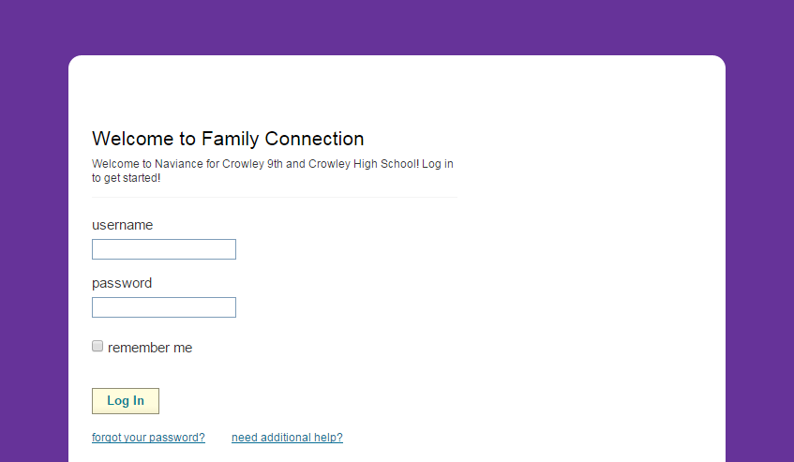
Login page
LOGIN HERE
Username: FL#####
Password: #####

Slide 21
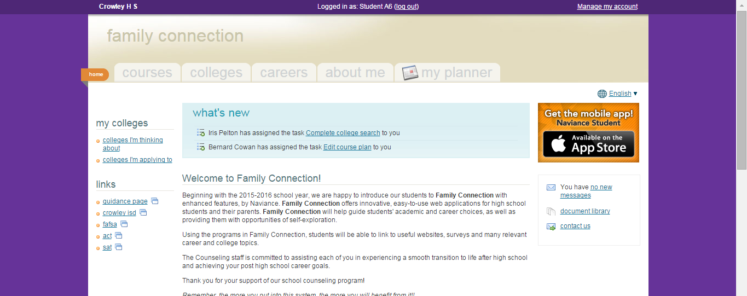
CLICK HERE

Slide 22
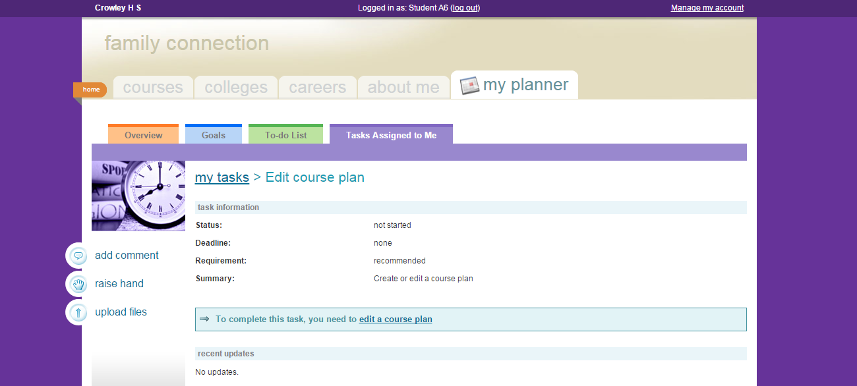
CLICK HERE

Slide 23
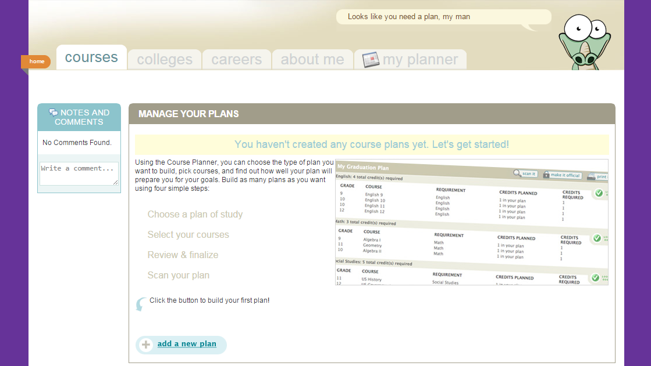
CLICK HERE

Slide 24
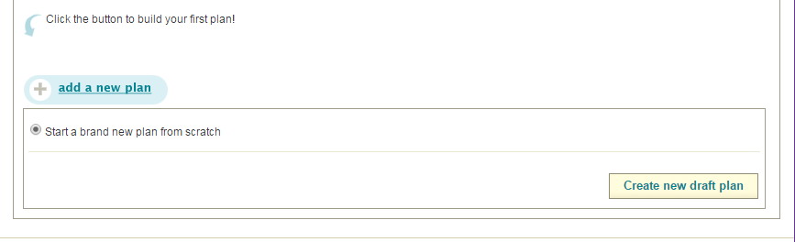
Today, we will start a new plan from scratch!
If you work on it after today, you might choose to edit an already started plan, such as the one we start in class today.
CLICK HERE

Slide 25
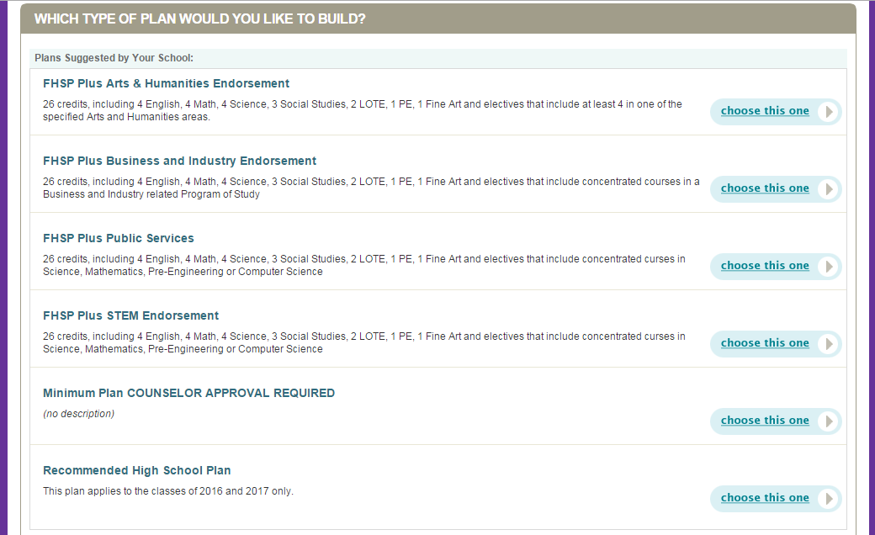
Choose the plan you are going to graduate on. Refer to previous information about which pathway to choose.

Slide 26
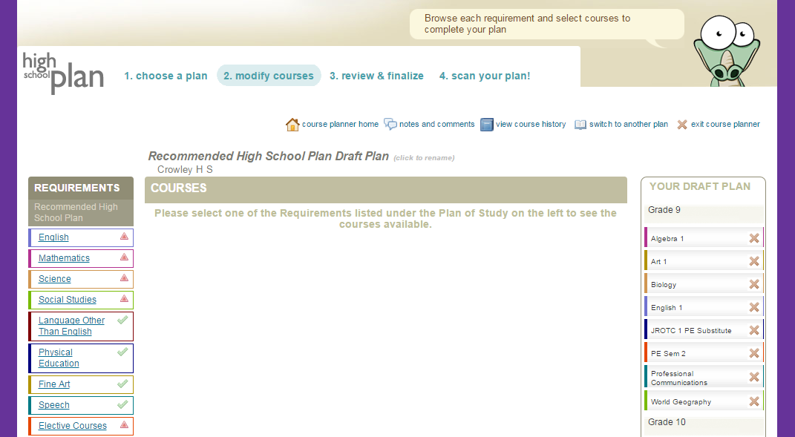
YOU CAN MAKE A NOTE TO YOUR COUNSELOR
SUBJECT AREAS TO FILL
CLASSES YOU’VE TAKEN OR ARE TAKING
GO AHEAD AND CLICK ON ENGLISH

Slide 27
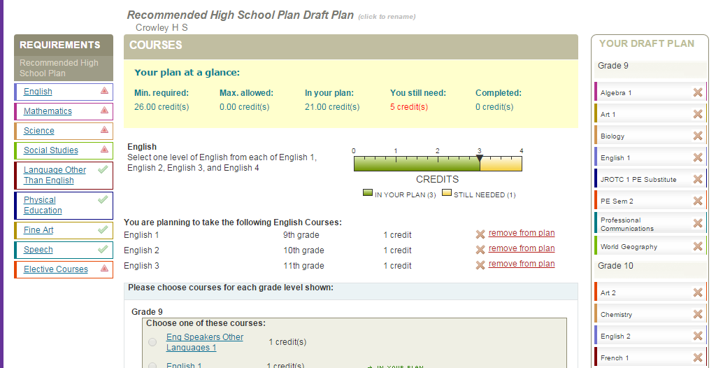
OVERVIEW OF CREDITS CHOSEN
INSTRUCTIONS ABOUT WHAT TO CHOOSE ON THIS PAGE
SCROLL DOWN…..

Slide 28
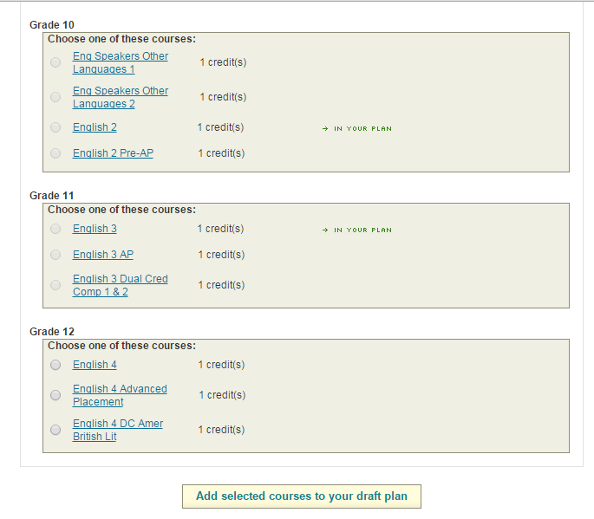
THIS MEANS IT IS ALREADY IN YOUR PLAN. YOU DON’T HAVE TO SELECT IT AGAIN.
CHOOSE COURSES TO MEET THE REQUIREMENTS
CLICK HERE TO ADD THEM TO YOUR PLAN!

Slide 29
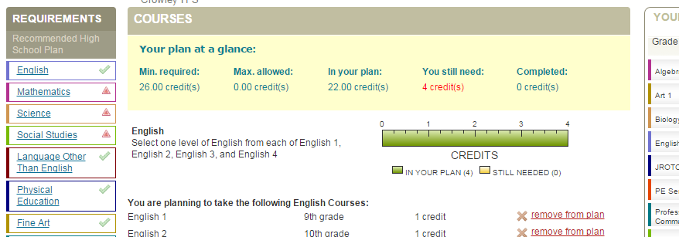
ONCE YOU’VE MET THE REQUIREMENTS FOR THAT SUBJECT AREA, THE RED TRIANGLE CHANGES TO A GREEN CHECKMARK!
THEN, YOU KEEP GOING THROUGH THE SUBJECTS UNTIL ALL REQUIREMENTS ARE MET

Slide 30
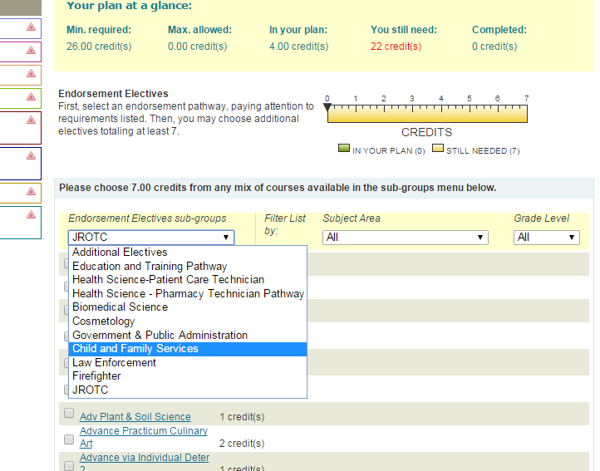
Be careful and read the instructions! Things can sometimes be a little tricky in the electives department.
On the Endorsement Electives category, you first have the use the drop-down to select your pathway.

Slide 31
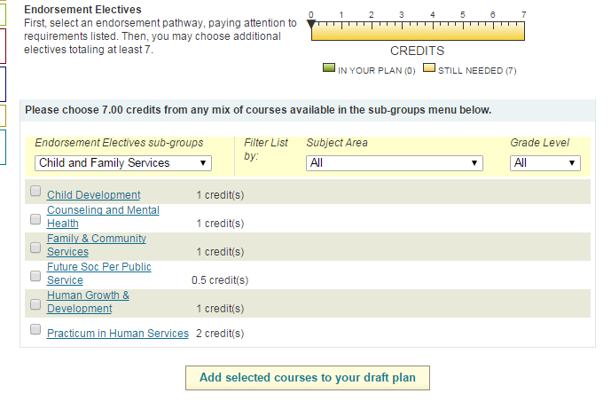
Then you’ll see a set of electives specific to your endorsement!
CHOOSE COURSES TO MEET THE REQUIREMENTS
CLICK HERE TO ADD THEM TO YOUR PLAN!

Slide 32
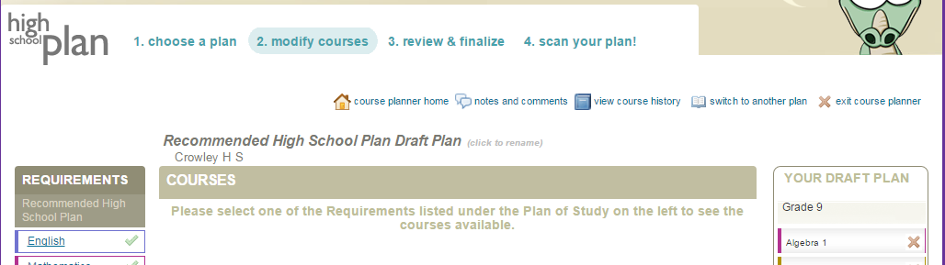
ONCE ALL REQUIREMENTS ARE MET AND YOUR 4 YEAR PLAN IS COMPLETE, CLICK HERE

Slide 33
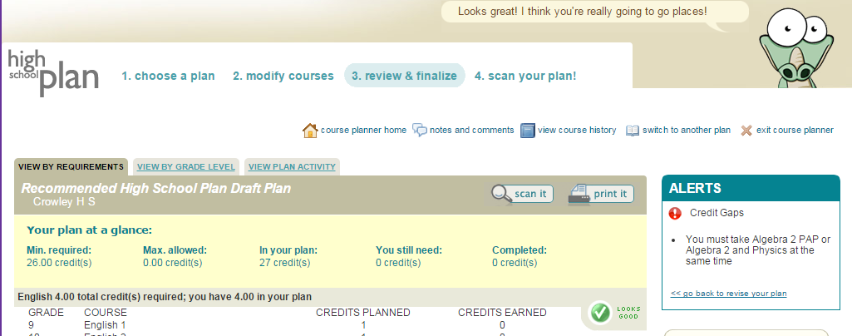
ONCE YOU’RE DONE, YOU CAN EXIT THE COURSE PLANNER! (scan your plan is not working yet)
USE THESE TABS TO VIEW YOUR COURSE PLAN AND MAKE SURE IT IS JUST THE WAY YOU WANT IT!

Slide 34

Don’t forget you will also have to pass 5 End of Course Exams in order to receive a Texas High School Diploma
English 1
English 2
Algebra 1
Biology
US History

Slide 35
Frequently asked questions
Can I choose more than one endorsement? – YES!
What if I do not complete the endorsement? – After your10th grade year, you and your parent, along with your counselor can discuss dropping to the foundation plan. But, this will limit your post-secondary options.
So, every student must take two years of foreign language? – Yes. This is consistent with what colleges are expecting of our students.
Does every student have to take Algebra 2? – In order to graduate on the Distinguished Achievement Plan, and to be offered AUTOMATIC admission (if you also rank in the top 10% of the graduating class) to a four-year state university within Texas, a student must successfully complete Algebra 2. (Top 7% for UT Austin)

Slide 36
What if I have questions?
Your 9th grade Counselor can help.
  CHS-9th:
    Debbie Lemke (debbie.mcdonald@crowley.k12.tx.us)
  NC-9th:
    Rhonda Smith (rhonda.smith@crowley.k12.tx.us)
    Zarinah Scott (zarinah.scott@crowley.k12.tx.us)
Your College and Career Readiness Counselors can help.
    Amy Kuhns (amy.kuhns@crowley.k12.tx.us)
    Mike Mabry (michael.mabry@crowley.k12.tx.us )

Slide 37
Online Course Selection
Online course selection will be open to students starting November 30th , 2015– January 15, 2016! Be sure to message or meet with your counselor if you have questions about your course selections for the 2016-2017 school year. You may also contact Mrs. Kuhns or Mr. Mabry at the BRJ CTE Center. Here is a quote to get you on your way to good course planning for your success in high school and beyond:
“Planning is bringing the future into the present so that you can do something about it now. “- Alan Lakein

